Slide 1
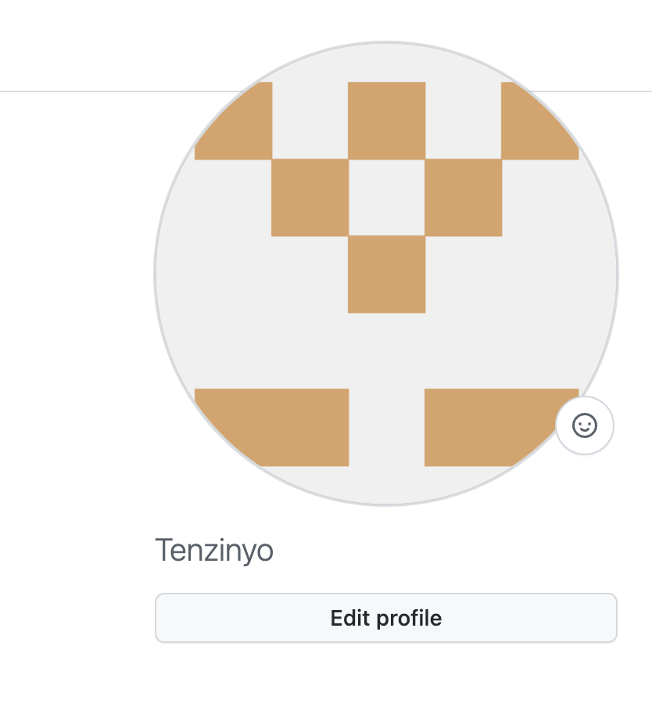
Part 1
GitHub account name: Tenzinyo

Slide 2
Part 2
Pandas Python
Sheets
Flourish

Slide 3
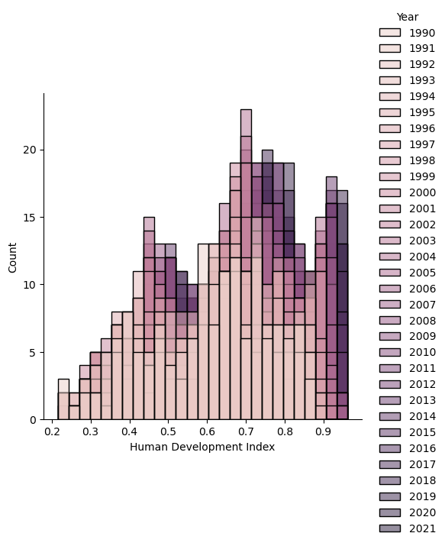
Pandas, Python Seaborn Displot
Using the Jupyter notebook and coding in pandas using python felt the most easiest and convenient as I am used to it, however i still did tackle some issues in the way. The graph on the left is made using the seaborn displot on the variables Year and Human Development Index and although there were a lot of countries the data could still fit in the graph which was very convenient and the use of different shades also made it look nicer and readable.

Slide 4
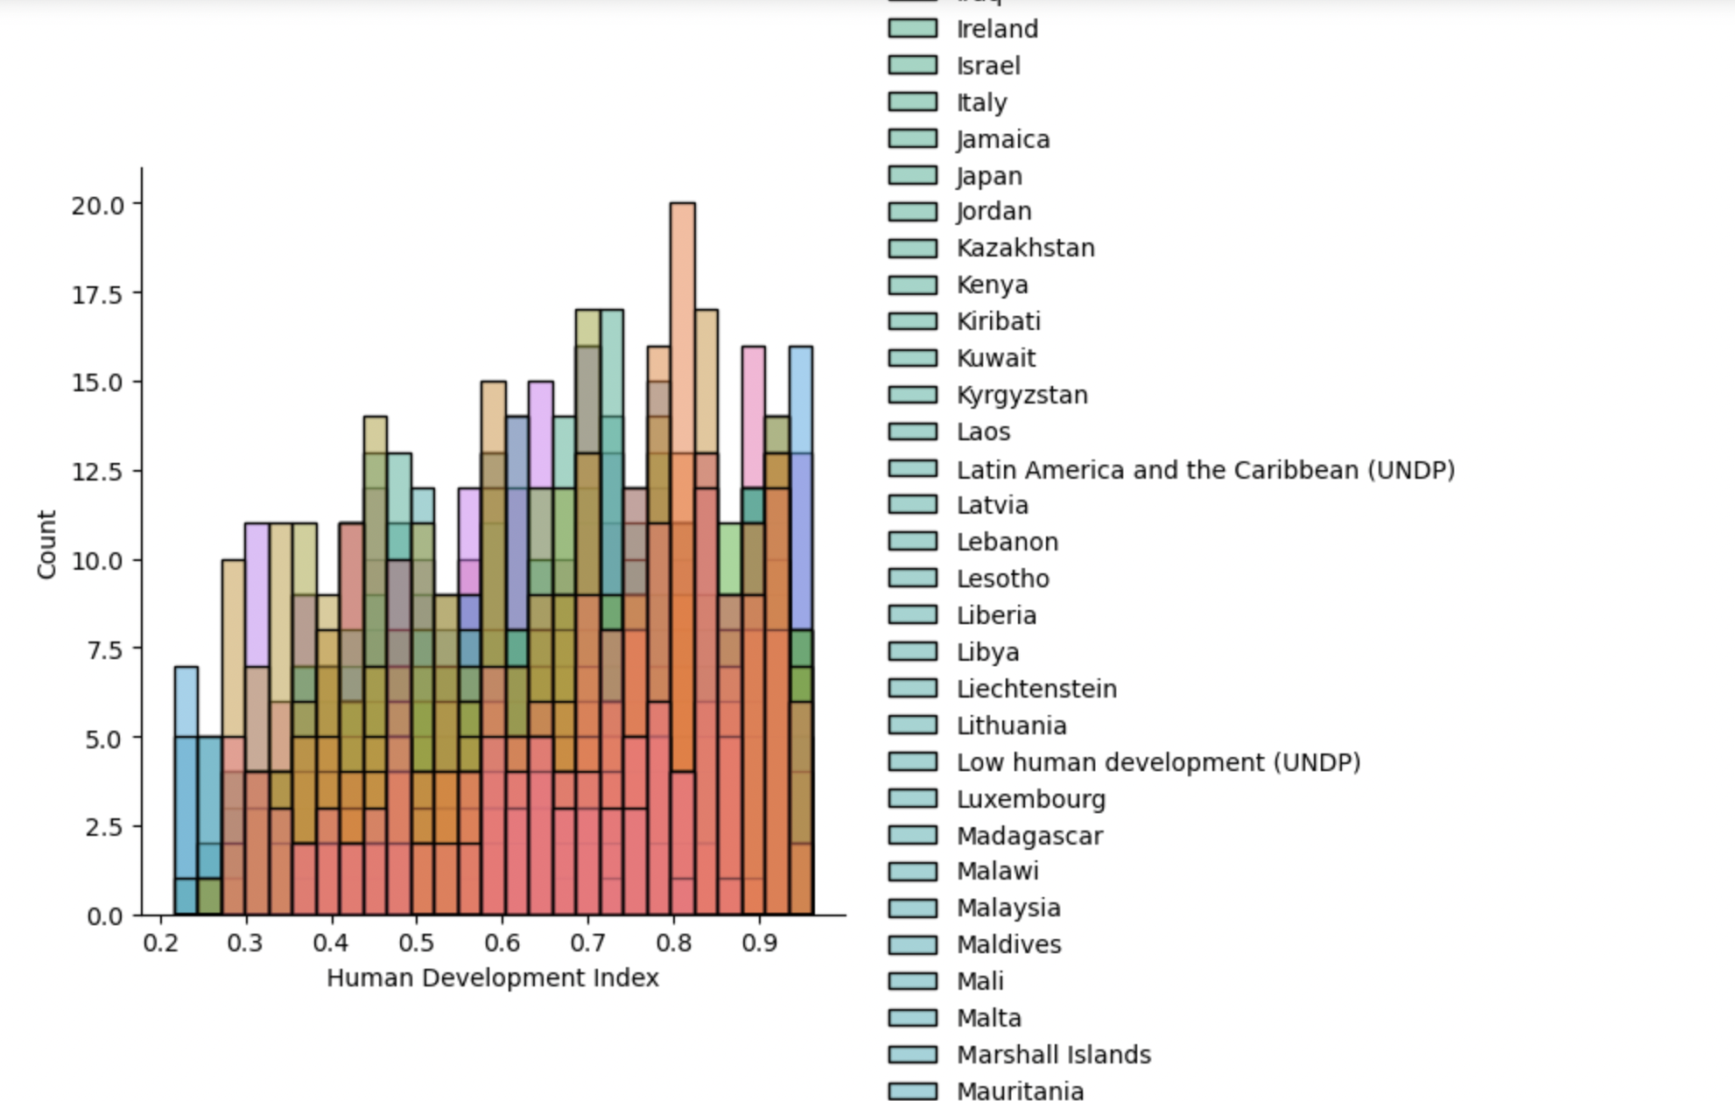
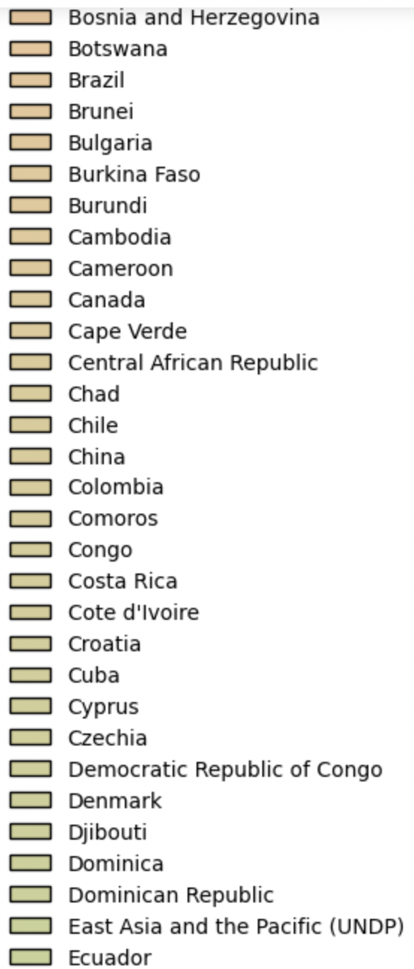
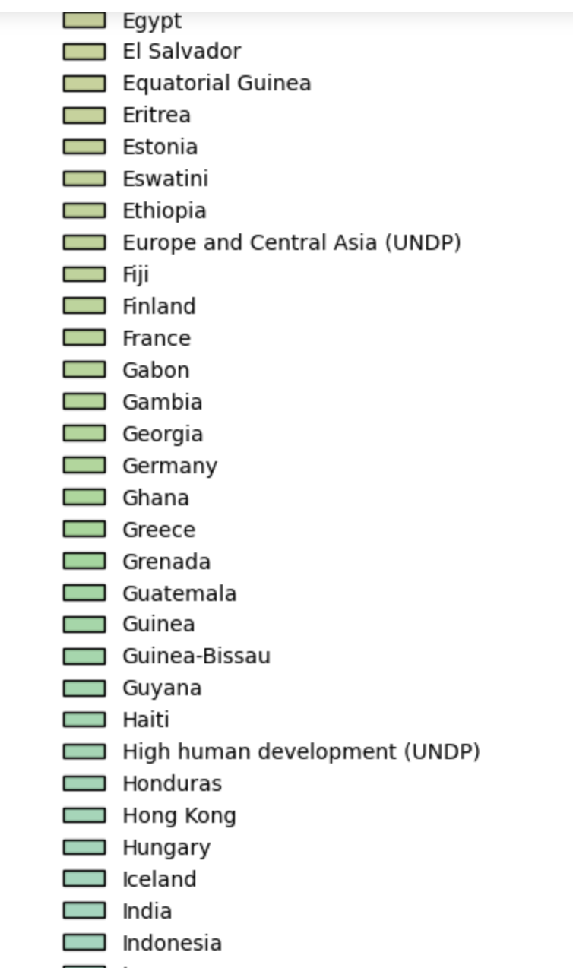
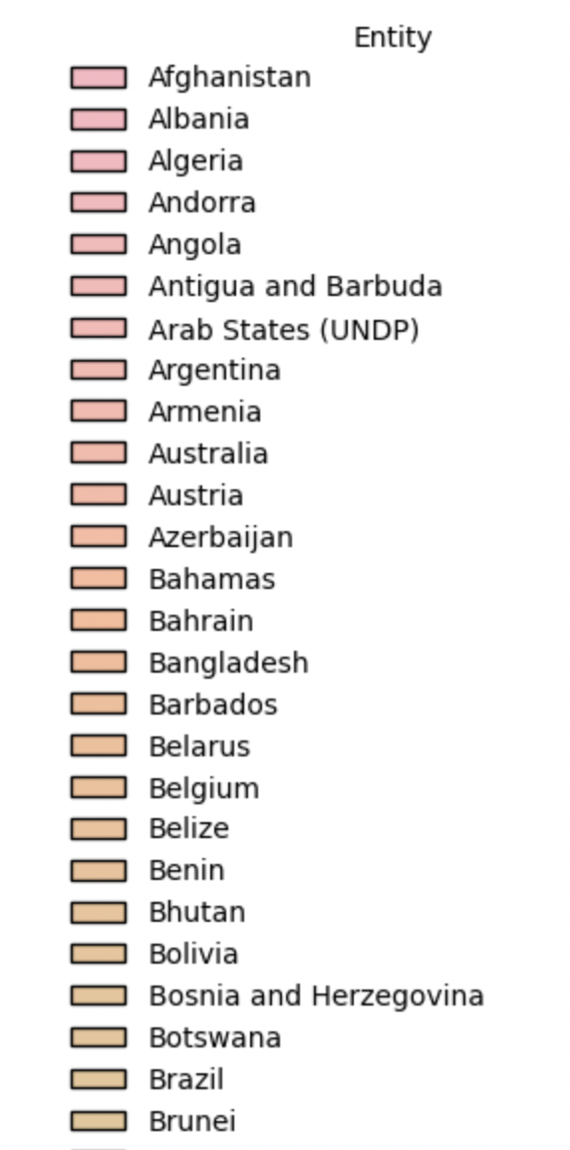
And many more countries!

Slide 5
Reflection:
The previous graph was also made using the pandas python library in particular, the seaborn function, but this time the variables were Entity which is the list of the Country names and the Human Development Index. Although there’s a lot going on in the graph due to the number of countries that were present in the data with the countries repeating a lot of times due to the change in the HDI over the years. But nevertheless, the machine is smart enough to understand that the same variables of the Entity, as it was repeating a lot of tums, it created a count to also regard the different years of increase or decrease in the HDI.

Slide 6
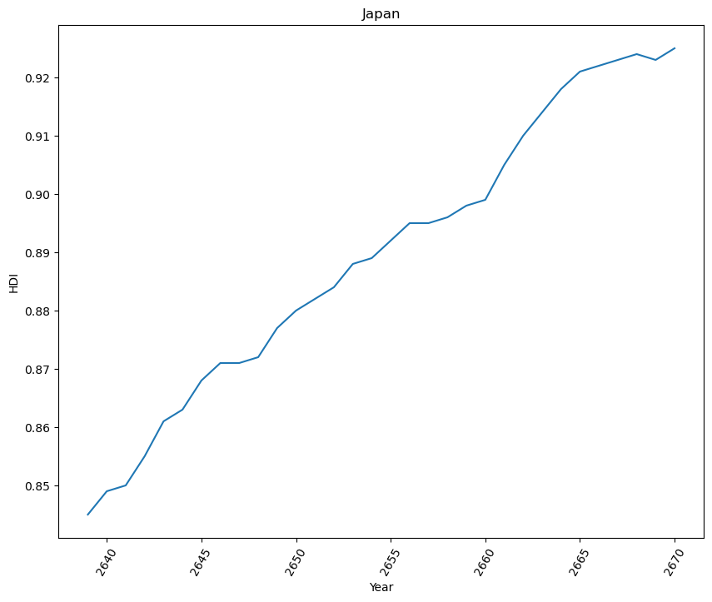
Python (Pandas & Jupyter Notebook)
This is a simple line plot solely focusing on Japan as Japan is considered one of the healthiest countries so I thought the HDI must be very high and it sure looks like it is doing well. The only thing that I was curious about was, why was it specifically focusing on the Years listed in the last indexes even though my code was generalised for all the years.

Slide 7
Reflection on the Pandas
As I am more familiar with using pandas and python language, it was easier for me to do some data visualization on it and also it was fun to explore the new visualization techniques that I learnt from previous weeks, especially on the sea-born techniques.
It was hard to fit in my data properly on the graphs as I have too many so I was only limited to using certain visualization tools which was not very convenient for me as I was just repeating the use of same tools.

Slide 8
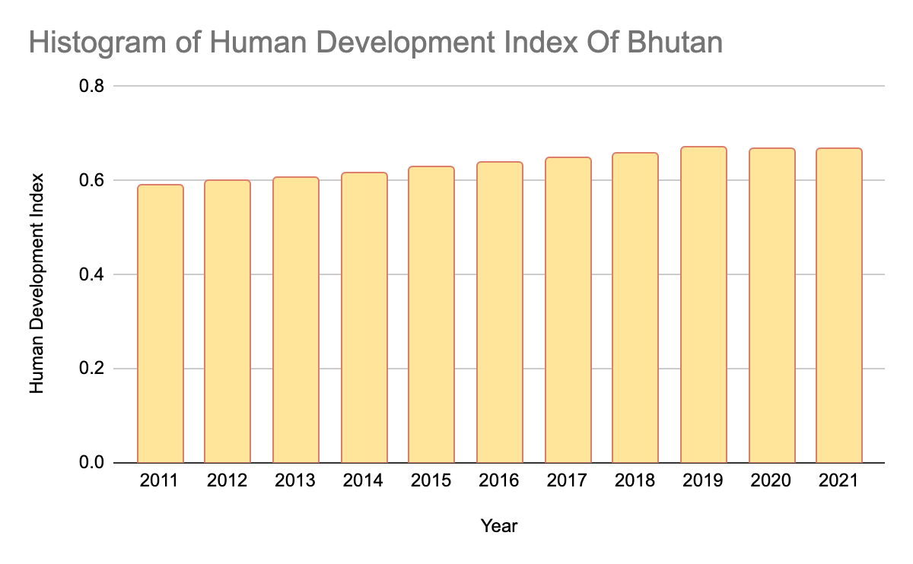
Spreadsheets
I being a Bhutanese, sparked so much curiousness for myself to see how my country has been doing in terms of its development until date. As I was using sheets, it’s interesting to see how we have been doing very well despite being a country with very low GDP and population (0.8 million ). Although there has not been much growth recently, Bhutan as a country has been doing pretty good with its initiatives in development.

Slide 9
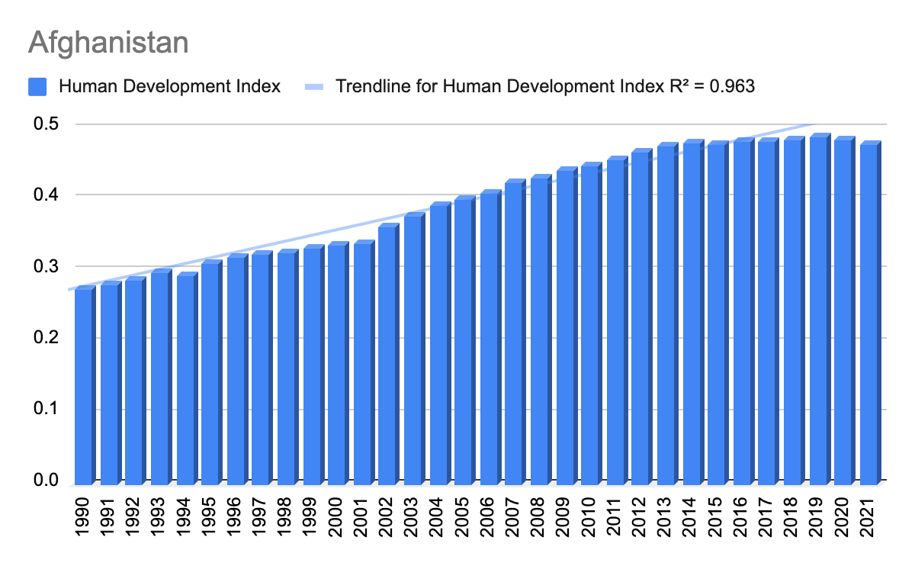
Google Sheets
I wanted to look at the HDI of Afghanistan over the Years and we can see that from the early 2000s its has been improving until the early 2010s when it started to fluctuate. Even when the regression line is showing that its almost closer to one meaning its the HDI has been improving, still I assume that there might be some error in the calculation as the trendline is not touching some of the bars, affecting the data calculation.

Slide 10
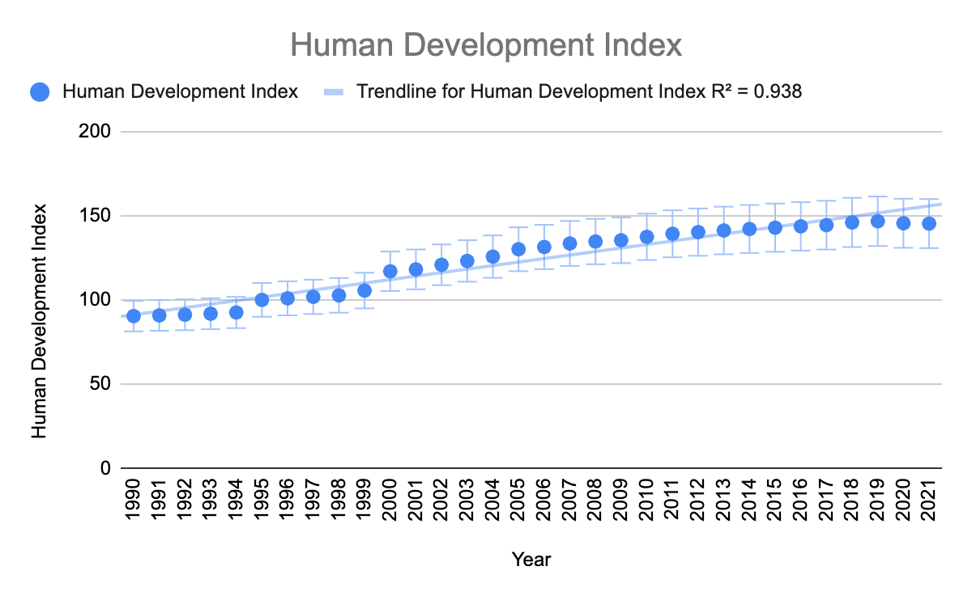
Spreadsheet
This graph created in the google spreadsheets shows the HDI of most countries throughout the years and can also calculate the R value of the variables fed to the graph.
While working in spreadsheet it was a bit difficult as the HDI for all the countries could not fit in the graph as it would be

Slide 11
Reflections on Spreadsheet
Very fast and efficient to use while still spending less time analyzing datas as compared to other data visualization tools.
As I have done spreadsheet during my middle school days, it was a good refresher and I could recollect all the skills that I have learnt earlier.

Slide 12
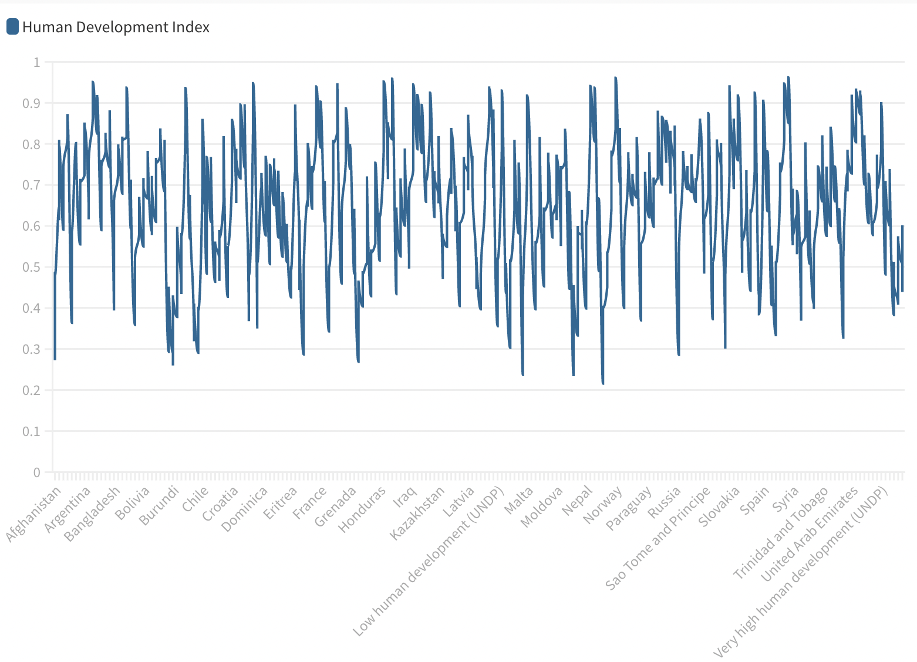
Flourish
Using Flourish has been very fun at the same time very nerverecking since the type of plots that I wanted to use are too advanced for the data set. Like the data on the right, since there is so much data, I am not able to specify some countries even though if you touch the lines you will be able to know some countries. Although I really liked surfing through the different data styles, it was a fun yet eye-opening journey.

Slide 13
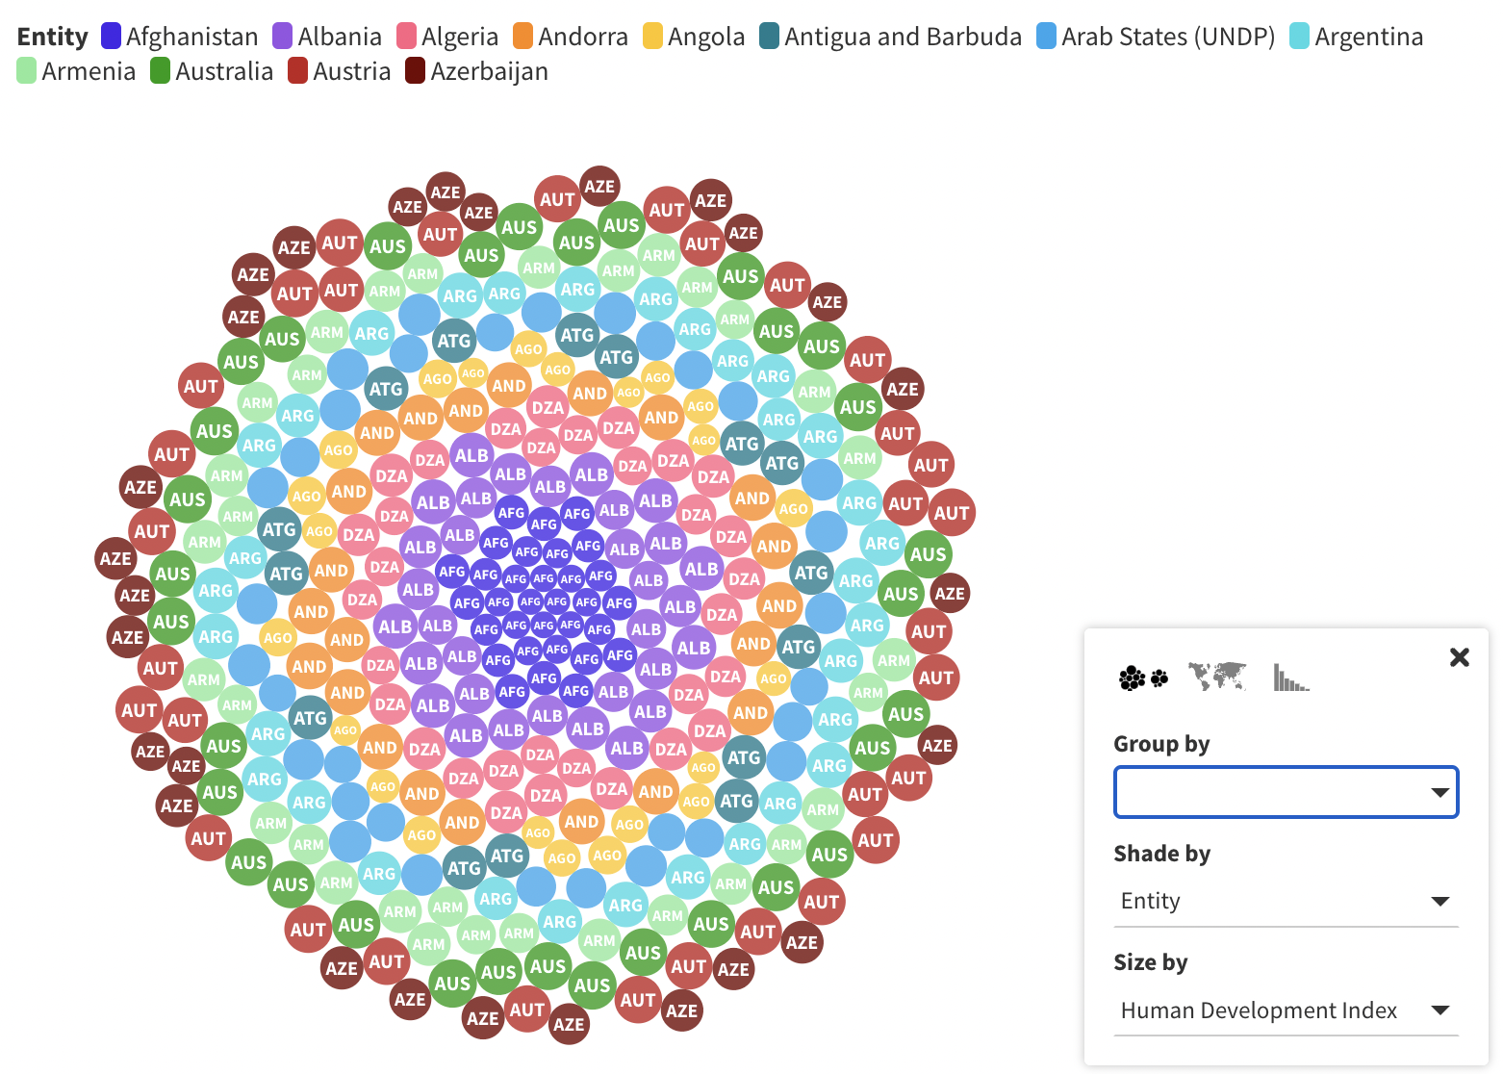
Flourish
While working in flourish it was so fun to see how we can use different tools and animations to describe our data.
The innermost countries are the countries with the least growth in Human Development Index.It was although very hard to fit in all of the countries so I decided to make graphs depending on the initials of the countries to make it easier for people to read off from the visualization.

Slide 14
Reflection on flourish
Flourish is a new concept to me as many so it was difficult figuring out which data table or visualization type to use, as the data that I had was very long or too less for some tools.
Nevertheless it was so fun seeing how many wide ranges of options that we have just to make data visualization so easier and more aesthetic.

Slide 15
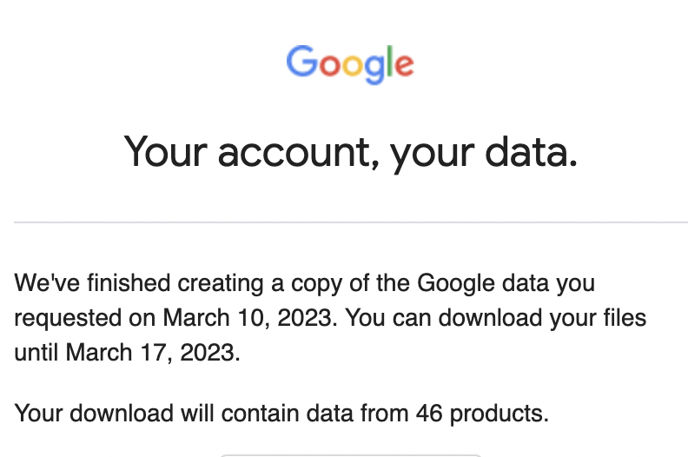
Part 3
I requested my google data including the 46 different features that google has and I requested it via email so it was very fast under two days.

